Slide 1
Group 5: Image Captioning
Vishalsinh Gadhvi
Leonid Grekhov
Himayu Mahnot
Adam Romayor
Vishwa Shah

Slide 2
VizWiz
Dataset
The VizWiz-Captions dataset includes:
23,431 training images
117,155 training captions
7,750 validation images
38,750 validation captions
8,000 test images
40,000 test captions
Notes:
Modified by Vishwa
Show images, and how each image has 5 captions.
Some captions are pre-canned or rejected. Can also explain that they are in json format.

Slide 3
Dataset Exploration
Raw Json Format of the reference caption:
{'caption': 'ITS IS A BASIL LEAVES CONTAINER ITS CONTAINS THE NET WEIGHT TOO.',
'id': 0,
'image_id': 0,
'is_precanned': False,
'is_rejected': False,
'text_detected': True}
Filtered the dataset based on the is_precanned and is_rejected to be false. So that the model is not trained on the false caption reference.
Caption ID
Image ID (Aligned with Image Dataset)
Notes:
Modified by Vishwa
Show images, and how each image has 5 captions.
Some captions are pre-canned or rejected. Can also explain that they are in json format.

Slide 4
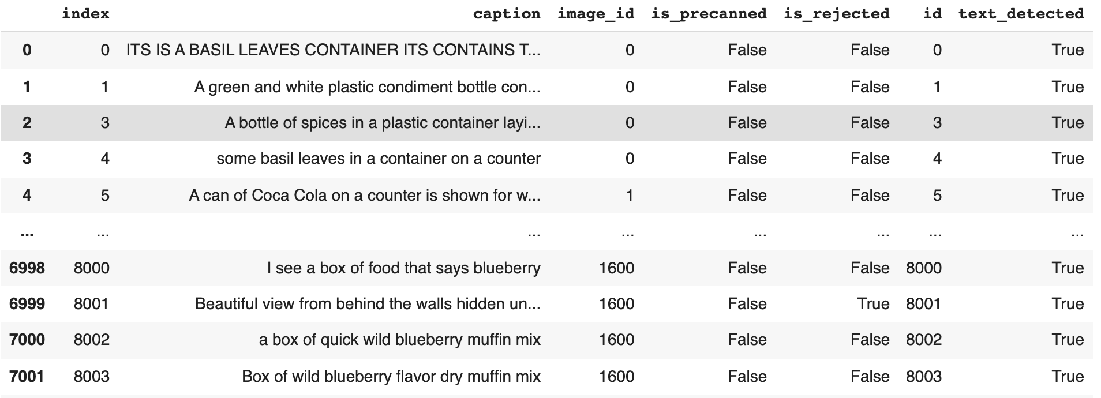
Data Exploration
(From JSON format to panda Dataframe)
Notes:
Modified by Vishwa

Slide 5
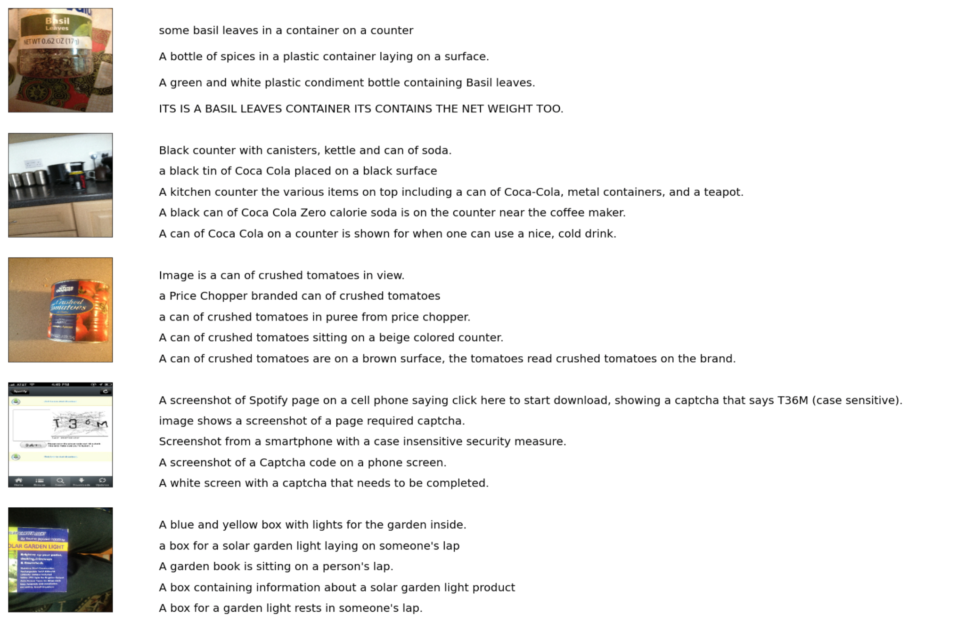
Dataset Exploration
Notes:
Modified by Vishwa

Slide 6
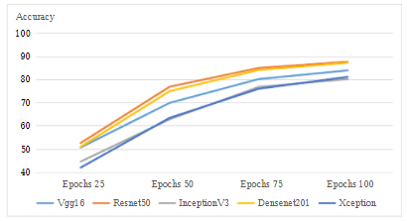
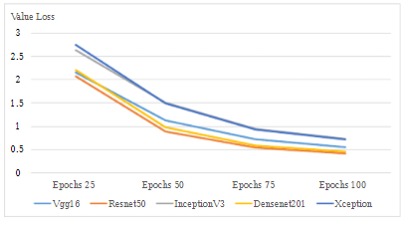
Related Work
The standard approach to image captioning is to use a Convolutional neural network to encode images. Decoding is then done for image captioning. In the related work the group used 5 neural networks and compared them against each other to judge the accuracy of the encoders from the pre-trained networks. Removing punctuation, converting all the letters to lowercase, taking unique words and pre-process the text was done to prepare image captioning. They used RMSprop optimizer for Resnet50, Vgg16, InceptionV3, Densenet201 and Xception.
https://www.researchgate.net/publication/355978058_Comparison_of_Different_CNN_Model_used_as_Encoders_for_Image_Captioning

Slide 7
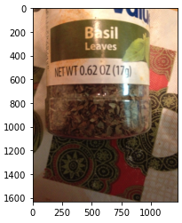
Data Preprocessing:
Text
Remove punctuation and lowercase all letters.
Filter out all captions that are pre-canned or rejected.
Add ‘startseq’ and ‘endseq’ to each caption.
Original:
“ITS IS A BASIL LEAVES CONTAINER ITS CONTAINS THE NET WEIGHT TOO.”
Preprocessed:
“startseq its is a basil leaves container its contains the net weight too endseq”

Slide 8
Data Preprocessing:
Text Embedding
Generate vocabulary based on training captions
Create Embedding Matrix:
Each word in the vocab gets an index.
Each column in the matrix represents the GloVe Embedding of that word.
Dimensions (vocab_size x 200)
E.g. if the word ‘hello’ has index 5, then the embedding_matrix [5] will have a 200 dimension vector from the GloVe embedding file.

Slide 9
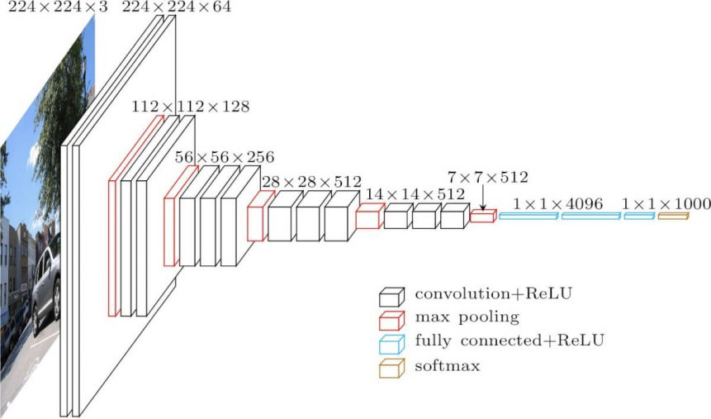
Data Preprocessing: Images
Use transfer learning to pass an image through a CNN.
Remove the classification layer, so we are left with feature vectors.
VGG16: Remove the softmax layer, so the output vectors are 4,096 x 1

Slide 10
Model Architecture
The model will have two inputs:
One input is the feature vector of an image
An image after it goes through the CNN
The other input is a padded sequence of words with length 56.
Given a photo and a sequence of words, the model will predict the next word in the sequence.

Slide 11
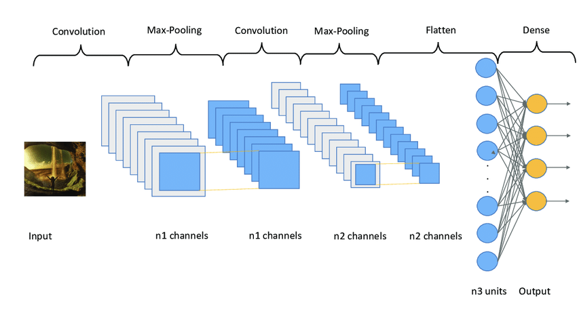
Model Architecture: Feature Vector Input
The first input is the feature vector of an image
Example Code:
input1 = Input(shape=(ENCODER_OUTPUT_DIM,))
fe1 = Dropout(0.5)(input11)
fe2 = Dense(512, activation='relu')(fe1)
fe3 = Dense(256, activation='relu')(fe2)
https://www.researchgate.net/figure/A-vanilla-Convolutional-Neural-Network-CNN-representation_fig2_339447623

Slide 12
Model Architecture: Text Sequence Input
The input is a sequence of words with shape (56, )
The max length of a caption is 56 words
The embedding layer has dimensions (vocab_size, 200)
Freeze the embedding layer.
After the embedding layer it is passed through an NLP model.
Example input:
‘This’ ‘is’
[0, 0, 0, ……, 0, 0, 234, 345]
Example Code:
input2 = Input(shape=(max_length,))
se1 = Embedding(vocab_size, embedding_dim, mask_zero=True)(input2)
se2 = Dropout(0.5)(se1)
se3 = Bidirectional(LSTM(128, return_sequences=True))(se2)
se4 = Bidirectional(LSTM(128))(se3)

Slide 13
Model Architecture: Output
Both models are combined using an Add layer.
The output is a Dense layer with an output shape of the vocab size and a softmax activation function.
This will output the probabilities of the next word in the sequence.
Example Code:
decoder1 = add([fe3, se4])
decoder2 = Dense(256, activation='relu')(decoder1)
outputs = Dense(vocab_size, activation='softmax')(decoder2)

Slide 14

Model Training
One caption is split into multiple sequences.
The output will be the next word in the sequence or ‘endseq’.
Adam optimizer
categorical_crossentropy loss function.
Trained on 1000 images with at most 5 captions per image.
Input 1:
Input 2:
[0 ,0, 0, …, 0, 0, ‘the’, ‘cat’, ‘in’, ‘the’]
Output:
[‘hat’]

Slide 15
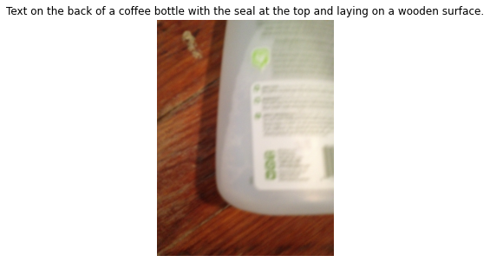
Caption Generation
Greedy Search:
The photo is passed to the model with “startseq” as the first input.
The word with the highest probability is appended to the sequence.
The photo and new sequence are passed to the model.
Stop once the model predicts “endseq” or the max length of the caption.

Slide 16
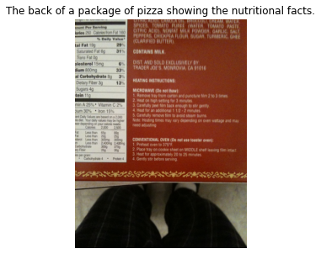
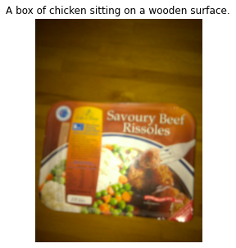
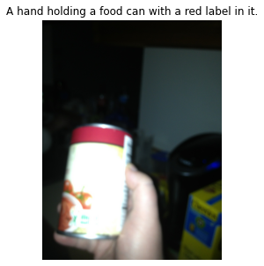
Results - Vgg16 and Bidirectional LSTM
Bleu-1: 0.45 | Bleu-2: 0.20 | Bleu-3: 0.06 | Bleu-4: 0.02

Slide 17
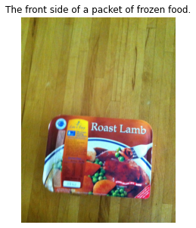
Results - InceptionV3 and Bidirectional LSTM
Bleu-1: 0.41 | Bleu-2: 0.19 | Bleu-3: 0.33 | Bleu-4: 0.44
a person is holding a box of hersheys pills
a person is holding up a box of cold and flu pills
a can of great value corn sits on a counter

Slide 18
Results - Resnet50 and Bidirectional LSTM
Bleu-1: 0.50 | Bleu-2: 0.23 | Bleu-3: 0.38 | Bleu-4: 0.48
the back of a box of frozen jello chips
the back side of a box of dog food with the instructions showing on the back
a person is holding a can of beer in the hand

Slide 19
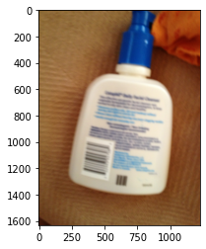
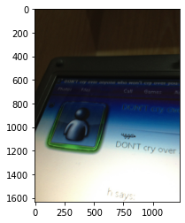
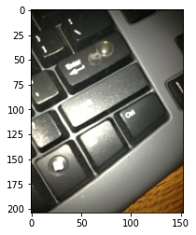
Results - InceptionResNetV2 and LSTM
Bleu-1: 0.38 | Bleu-2: 0.39 | Bleu-3: 0.47 | Bleu-4: 0.53
a white bottle of some sort of brand product
a digital screen is laying on a desktop
a small electronic keyboard for a small screen or surface

Slide 20
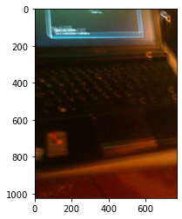
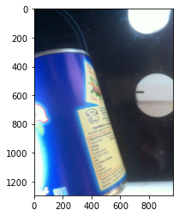
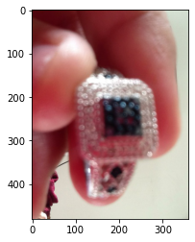
Results - DNN201 and Bidirectional LSTM
Bleu-1: 0.018 | Bleu-2: 0.13 | Bleu-3: 0.26 | Bleu-4: 0.36
the keyboard and bottom screen of a laptop
a can with blue label showing the nutrition label
someone is holding a ring in his hand

Slide 21
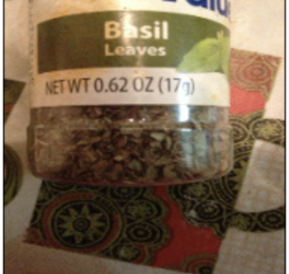
Model : InceptionV3 + Attention Model
General Architecture:
Motivation : Show, Attend and Tell
Feature vector of dimension of last fully connected layer of chosen CNN model
Image Encoder(CNN)
Sequence Decoder (LSTM - GRU)
Decoded sequence
Attention Module
startseq
Sequence Generator
The can….
Notes:
Modified by Vishwa

Slide 22
Model Training : Attention Model
Step 1 : Encoding image
Input : (batch_size, 299, 299) Output : (batch_size, 8,8, 2048)
Step 2: Tokenize Captions
Input : Sequence of english words
Output:
Word to index and index to word dictionary
Size of dictionary = Vocabulary size
Step 3: Pad all the captions with max length of the caption in dataset = 81
Step 4: CNN encoder
Input: (batch_size, 64, 2048)
Output: (batch_size, 64, embedding_dim)
Step 5: Language Model with attention
Input: Feature vector with attention weights + word vector of <startseq>
Output: (batch_size * max_length, vocab_size)
Probability distribution of the each word in the vocabulary.
Optimizer : Adam Metrics : Categorical cross entropy loss

Slide 23
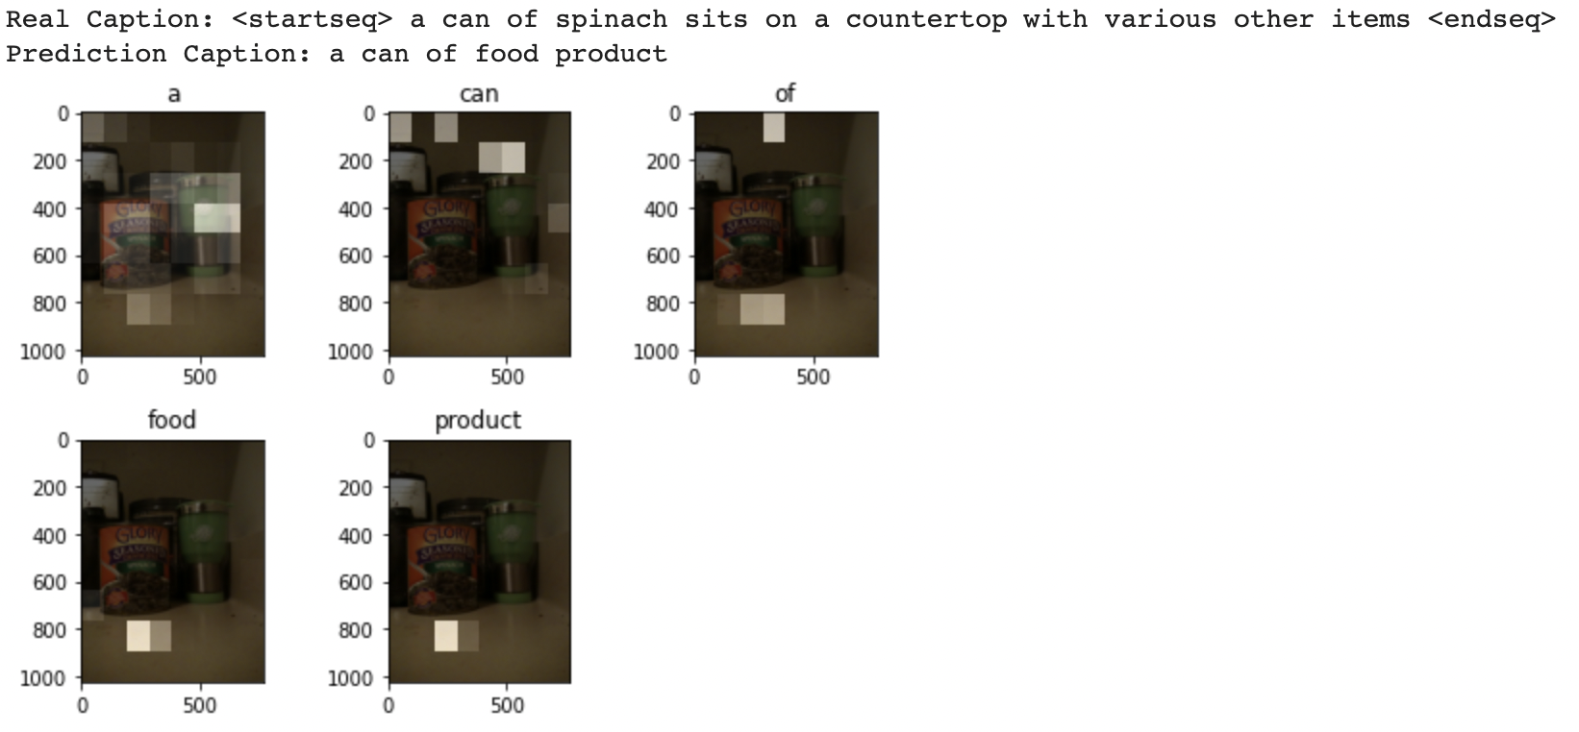
Predicted caption and attention plot
Bleu-1: 0.13 | Bleu-2: 0.34 | Bleu-3: 0.48 | Bleu-4: 0.56

Slide 24
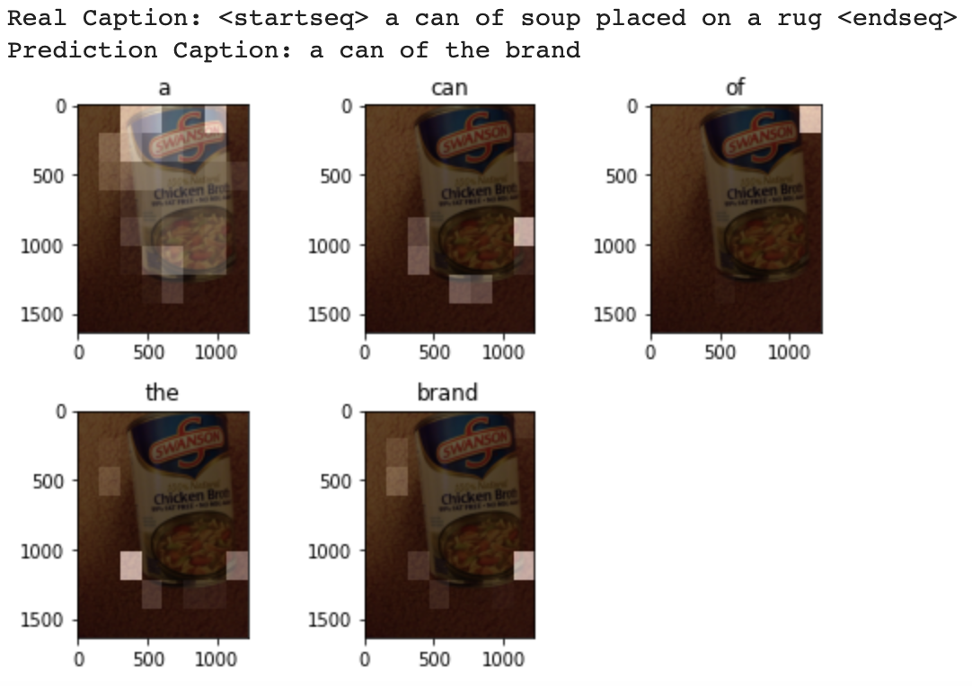
Predicted caption and attention plot

Slide 25
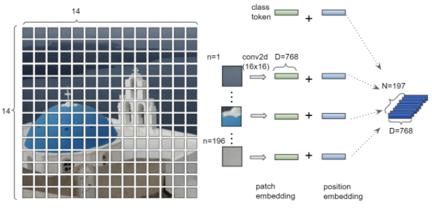
Future Improvements
Vision Transformer
Use More Data

Slide 26
Thank You!

